Slide 1
STRUKTUR DATA
Pertemuan 1

Slide 2
Struktur data
Proses mengelola data dalam memori. Terdapat jenis stuktur data berupa data primitif dan data non primitif. Struktur data primitif misal int, char, float, double sedangkan Struktur data non primitif dibagi menjadi dua jenis data linear atau non linear.

Slide 3
Struktur data
Struktur data juga bisa di golongkan dalam statis atau dinamis. Struktur data statis memiliki ukuran yang tetap, sedangkan Struktur data dimanis memiliki ukuran bebas. Tujuan utama dari struktur data adalah Searching (Pencarian), Sorting (Pengurutan), Insertion (Penyisipan), Updation (Perbaruan), dan Deletion (Penghapusan). Struktur data memiliki keuntungan lebih Efisiensi, Reusability, Abstraksi.

Slide 4
Struktur data
Dalam menyelesaikan struktur data diperlukan sebuah algoritma, dimana algoritma adalah proses aturan yang di perlukan untuk melakukan perhitungan dalam pemecahan masalah. Ciri ciri algoritma yaitu terdapat proses input, output, tidak membingungkan, independent, modularitas, fungsionalitas, kemudahan, sederhana. Proses pendekatan dalam algoritma

Slide 5
Array
Arrays are defined as the collection of similar type of data items stored at contiguous memory locations.
Arrays are the derived data type in C, Java, C# programming language which can store the primitive type of data such as int, char, double, float, etc.
Array is the simplest data structure where each data element can be randomly accessed by using its index number.
For example, if we want to store the marks of a student in 6 subjects, then we don't need to define different variable for the marks in different subject. instead of that, we can define an array which can store the marks in each subject at a the contiguous memory locations.

Slide 6
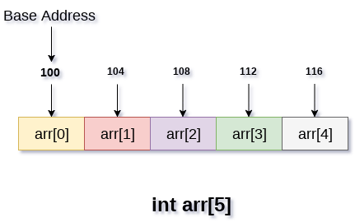
Java Arrays: Arrays are used to store multiple values in a single variable, instead of declaring separate variables for each value.

Slide 7
Accessing Elements of an array
To access any random element of an array we need the following information:
Base Address of the array.
Size of an element in bytes.
Which type of indexing, array follows.
To declare an array, define the variable type with square brackets:
String[] cars
We have now declared a variable that holds an array of strings. To insert values to it, we can use an array literal - place the values in a comma-separated list, inside curly braces:
String[] cars = {"Volvo", "BMW", "Ford", "Mazda"}
To create an array of integers, you could write:
int[] myNum = {10, 20, 30, 40}
Access the Elements of an Array
String[] cars = {"Volvo", "BMW", "Ford", "Mazda"}
System.out.println(cars[0])

Slide 8
Change an Array Element
String[] cars = {"Volvo", "BMW", "Ford", "Mazda"};
cars[0] = "Opel";
System.out.println(cars[0]);
// Now outputs Opel instead of Volvo
Array Length
String[] cars = {"Volvo", "BMW", "Ford", "Mazda"};
System.out.println(cars.length);
// Outputs 4
Loop Through an Array
String[] cars = {"Volvo", "BMW", "Ford", "Mazda"};
for (int i = 0; i < cars.length; i++) {
System.out.println(cars[i]);
}
Loop Through an Array with For-Each
String[] cars = {"Volvo", "BMW", "Ford", "Mazda"};
for (String i : cars) {
System.out.println(i);
}

Slide 9
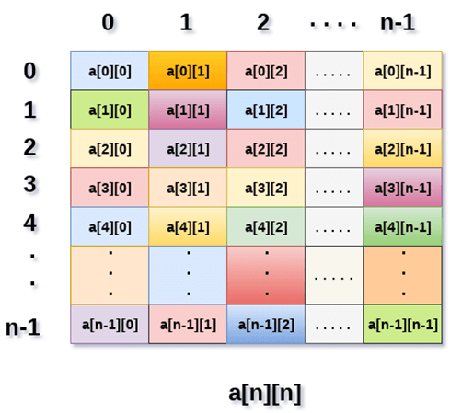
To access the elements of the myNumbers array, specify two indexes: one for the array, and one for the element inside that array.

Slide 10
This example accesses the third element (2) in the second array (1) of myNumbers:
int[][] myNumbers = { {1, 2, 3, 4}, {5, 6, 7} }
int x = myNumbers[1][2]
System.out.println(x) // Outputs 7
We can also use a for loop inside another for loop to get the elements of a two-dimensional array (we still have to point to the two indexes):
public class Main {
public static void main(String[] args) {
int[][] myNumbers = { {1, 2, 3, 4}, {5, 6, 7} };
for (int i = 0; i < myNumbers.length; ++i) {
for(int j = 0; j < myNumbers[i].length; ++j) {
System.out.println(myNumbers[i][j]);
}
}
}
}

Slide 11
import java.util.Scanner;
publicclass TwoDArray {
publicstaticvoid main(String[] args) {
int[][] arr = newint[3][3];
Scanner sc = new Scanner(System.in);
for (inti =0;i<3;i++)
{
for(intj=0;j<3;j++)
{
System.out.print("Enter Element");
arr[i][j]=sc.nextInt();
System.out.println();
}
}
System.out.println("Printing Elements...");
for(inti=0;i<3;i++)
{
System.out.println();
for(intj=0;j<3;j++)
{
System.out.print(arr[i][j]+"\t");
}
}
}
}

